Slide 1
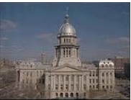
Illinois State Constitution
Take all notes!

Slide 2
3 Branches of Government
Legislative Branch: makes laws
Executive Branch: carries out laws
Judicial Branch: explains laws
All members of these branches are elected by the people of Illinois

Slide 3
Legislative Branch (General Assembly)
2 houses: Senate and House of Representatives
Members represent the district that they live in.
To become a member of this branch (Qualifications):
At least 21 years old
U.S. citizen
Resident of the district for at least 2 years
Term in office: 2 years (can be re-elected)

Slide 4
Legislative: Senate
Has 59 senators
One senator for each legislative district
Joliet (43rd district)
Senator: A.J. Wilhelmi
Remember Qualifications:
At least 21 years old
Live in district for 2 years
Be a United States citizen

Slide 5
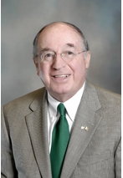
Legislative: House of Representatives
118 Representatives: two from each legislative district (43rd is split in 2 representative districts: 85th and 86th (Joliet)
Joliet Legislative District 86 Rep:
Jack McGuire- Democrat
Remember:
I only serve for 2 years…then I got to get elected again

Slide 6
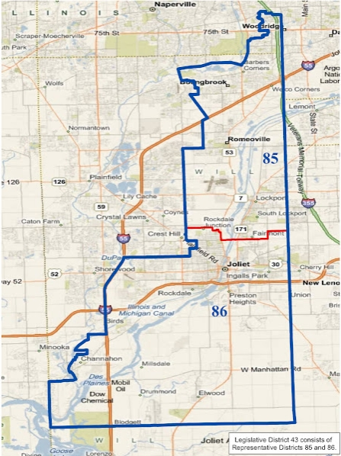
43rd District: Reps from 85th and 86th
Emily McAsey-D
Jack McGuire- D

Slide 7
Executive Branch
6 elected officials
Serve four years
Qualifications to be a member
At least 25 years old
U.S. citizen
Resident of Illinois for at least 3 years
Remember carry out the laws
Voted by the people of Illinois

Slide 8
Executive Branch Members
Governor: Pat Quinn
Chief Executive Officer (signs/vetoes bills, creates state budget, can approve bill by eliminating certain parts)
Lieutenant Governor: Sheila Simon
Takes over as governor if necessary
Attorney General: Lisa Madigan
Chief legal officer and law enforcement officer
Performs duties given by the governor

Slide 9
Executive Branch Members
Secretary of State: Jesse White
Keeps official records of General Assembly and Executive office
Comptroller: Judy Baar Topinka
Chief fiscal officer; pays the bills
Treasurer: Dan Rutherford
Acts as the state’s banker by keeping and investing money received through state taxes
Licenses drivers, keeps records of vehicle registration

Slide 10
Judicial Branch
Here’s the 3 branches!
Supreme Court
Appellate Courts
District Courts

Slide 11
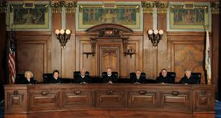
Judicial Branch: Supreme Court and Appellate Courts
Supreme Court
7 justices
Elected by the people
Term: 10 years
Hear appeals from lower courts
Appellate Courts
54 appellate judges
5 districts of courts
Elected by the people
Term: 10 years

Slide 12
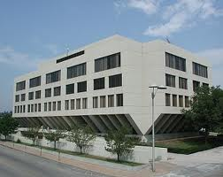
Judicial Branch: District Courts
Illinois is divided into 23 judicial circuits
Most cases are heard here
Each circuit has:
Chief judge
Circuit judges
Associate judges
Circuit Judges:
Elected by the people
Term: 6 years
Associate judges:
Appointed by circuit judges
Term: 4 years
Notice
difference
Will County Circuit Court District 12 in Joliet

Slide 13
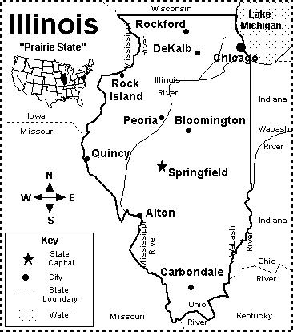
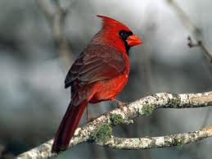
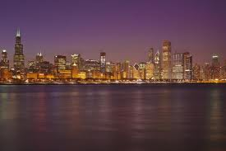
Illinois Facts
Became a state in 1818
Current constitution used was written in 1970

Slide 14
Preamble
Introduction to why the constitution was written (Don’t write—not tested):
We, the People of the State of Illinois-grateful to Almighty God for the civil, political and religious liberty which He has permitted us to enjoy and seeking His blessing upon our endeavors-in order to provide for the health, safety and welfare of the people; maintain a representative and orderly government; eliminate poverty and inequality; assure legal, social and economic justice; provide opportunity for the fullest development of the individual; insure domestic tranquility; provide for the common defense and secure the blessings of freedom and liberty to ourselves and our posterity - do ordain and establish this Constitution for the State of Illinois.

Slide 15
Article 1: Bill of Rights
States many of the individual rights and liberties found in the Bill of Rights of the U.S. Constitution
freedom of religion
freedom of speech
the right to assemble and petition
the right to bear arms
freedom from self incrimination
the right to a trial by jury

Slide 16
Article 1: Bill of Rights (cont.)
Guarantees due process and equal protection
Everyone is entitled to the same basic rights and the same fair procedures under the law.
Forbids discrimination on the basis of sex and on the basis of physical or mental handicaps.
The right of eminent domain
Eminent domain allows the government to purchase private property for public use.
For example, if a piece of land is needed to build a highway or a bridge to be used by all the people, the state has the right to buy the land for a fair price even if the owner does not want to sell the land.

Slide 17
Article 2: Powers of the State
Article II of the Illinois Constitution divides the state government into 3 branches:
Legislative
Executive
Judicial
These branches or divisions are the same as the federal government.

Slide 18
Article 3: Suffrage and Election
Sets up voting qualifications and election laws.
To vote a person must be
a U.S. citizen
18 years old
resident of Illinois for at least 30 days prior to the election.
People must register to vote in the county they live.

Slide 19
Article 4: Legislative Department
Provides rules for General Assembly divided into 2 houses:
Senate (59 total senators)
House of Representatives (118 total reps)
Divides state into 59 legislative districts
Every 10 years state must re-district based on census
Must be compact, contiguous, and numbers in population
States that officials are voted by the people
Allow General Assembly to override a veto with a 3/5 (three-fifths) vote.

Slide 20
Article 5: Executive Branch
Provides rules for Executive Branch
6 officials (Gov, Lt. Gov, etc)
Age and resident requirements
Assigns duties of elected officials
Remember the faces or names of the officials like Gov. Pat Quinn and more…this is the article for those people

Slide 21
Article 6: Judicial Branch
Sets up the court system for Illinois
Circuit courts have original jurisdiction in most cases
Supreme Court has original jurisdiction in special cases (revenue, prohibition)
Judge Qualifications:
U.S. citizen
Licensed attorney in Illinois
Resident of circuit or district

Slide 22
Articles 7-8…know them
Article 7: Local Government
rules for local governments--for counties, townships, and cities.
Local governments are given limited powers to pass ordinances, or local laws.
Article 8: Finance
states that public money and property can only be used for public purposes.
explains how public funds are budgeted, spent and audited.

Slide 23
Articles 9-11…know them
Article 9: Revenue
describes how the state can collect money (revenue) from the people through taxes on property, income, and sales.
Article 10: Education
provides for free public education for all Illinois residents through high school.
Article 11: Environment
gives the General Assembly power to insure a healthy environment for Illinois residents.

Slide 24
Articles 12-13…know them
Article 12: Militia
allows the General Assembly to form a state militia (military force) made up of Illinois citizens.
The Governor acts as commander-in-chief of the state militia.
Article 13: General Provisions
gives several rules for persons running or holding office in Illinois.
states that public transportation is an essential public service, one which the General Assembly can spend public money on.

Slide 25
Article 14: Constitutional Revision
Explains how the Illinois Constitution can be changed.
Amendments to the Constitution may be proposed either by a Constitutional Convention or by the General Assembly.
If a Constitutional Convention is held to revise or amend the Constitution, a majority of Illinois voters must approve the changes.
If the amendments are proposed by the General Assembly, the amendments must be approved by three-fifths of the voters at the next general election.

