Slide 1
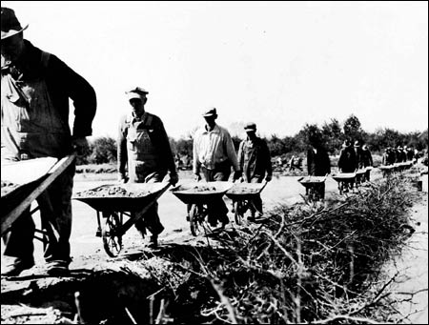
THE NEW DEAL
AMERICA GETS BACK TO WORK

Slide 2
Part 1: A NEW DEAL FIGHTS THE DEPRESSION
The 1932 presidential election showed that Americans were clearly ready for a change
Republicans re-nominated Hoover despite his low approval rating
The Democrats nominated Franklin Delano Roosevelt

Slide 3
ROOSEVELT WINS OVERWHELMING VICTORY
Democrat Roosevelt, known popularly as FDR, was a 2-term governor of New York
Roosevelt promised a “New Deal” for Americans and relief from the depression
“The only thing we have to fear is fear itself.”
FDR easily won the 1932 election

Slide 4
ROOSEVELT’S FIRESIDE CHATS
FDR communicated to Americans via radio
His frequent “Fireside Chats” kept Americans abreast of the government’s efforts during the Depression

Slide 5
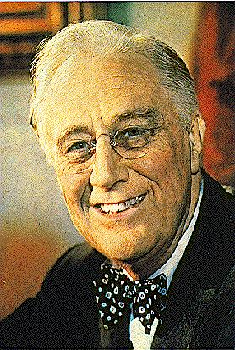
FDR LAUNCHES NEW DEAL
FDR promised a “new deal” for the American people
He took office with a flurry of activity known as “The Hundred Days”
The 100 Days lasted from March to June 1933

Slide 6
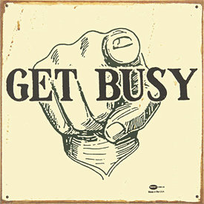
CONGRESS GETS BUSY
FDR’s philosophy was to get people help and work through “deficit” spending: spending money that is not available as cash.
During the 100 Days, Congress passed more than 15 major pieces of legislation that expanded government’s role in the nation’s economy and welfare

Slide 7
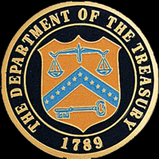
TO DO LIST: #1- HELP BANKS
First order of business was to get the banking system in order
On March 5, one day after taking office, FDR declared a bank holiday
He persuaded Congress to pass the Emergency Relief Act, which authorized the Treasury Department to inspect the nation’s banks

Slide 8
AMERICANS GAIN CONFIDENCE IN BANKS
Next, FDR passed the Glass-Steagall Act which established the Federal Deposit Insurance Corporation
The FDIC insured account holders up to $5,000 and set strict standards for banks to follow (today = $100,000)

Slide 9
ALPHABET AGENCIES

Slide 10
Your task
Complete the worksheet given.
Type in the agency’s acronym (ex. AAA)
Complete the chart.
Due at the end of the class!

Slide 11
CRITICS EMERGE
Despite the renewed confidence of many Americans, critics from both political spectrums emerged
Liberals (left) felt FDR’s program was NOT doing enough
Conservatives (right) felt that government intervention was TOO much and interfered with our free market economy

Slide 12
SUPREME COURT REACTS
Court strikes down several agencies
NIRA as unconstitutional (citing too much government control over industry)
AAA on the grounds that agricultural was a local matter -- not a federal matter
The Supreme Court -- 1935

Slide 13
FDR REGAINS CONTROL OVER SUPREME COURT
From the mid to late 1930s, FDR was able to appoint 7 new judges to the Supreme Court, thus assuring that his programs would carry on unabated

Slide 14
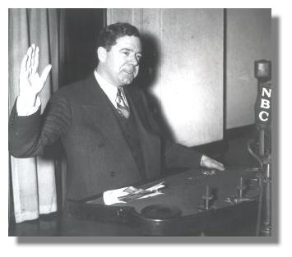
There were still critics
Father Charles Coughlin broadcast radio sermons slamming FDR
had 45 million listeners
Huey Long was a Senator from Louisiana who was a constant (and effective) critic of FDR
Long was setting up a run for president
A lone gunman assassinated Long at the height of his popularity
Coughlin
Long

Slide 15
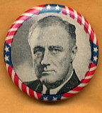
FDR EASILY WINS 2ND TERM
FDR wins in 1936

Slide 16
Part 2: THE SECOND NEW DEAL
Although the economy had improved during FDR’s first term (1932-1936), the gains were not as great as expected
Unemployment remained high and production still lagged

Slide 17
THE SECOND HUNDRED DAYS
FDR launches the “Second New Deal”
also called the “Second Hundred Days”
First priority was the farmers – FDR reinvigorated the AAA which provided aid for migrants, sharecroppers, and poor farmers
FDR authorized more than $1 billion to help tenant farmers become landowners

Slide 18
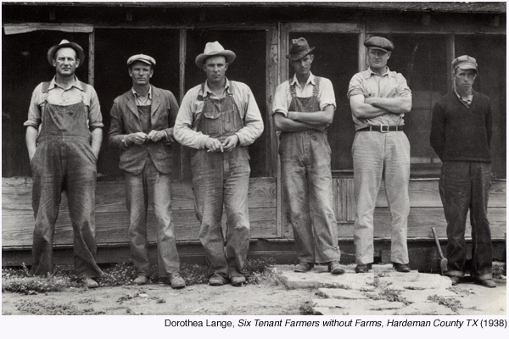

Slide 19
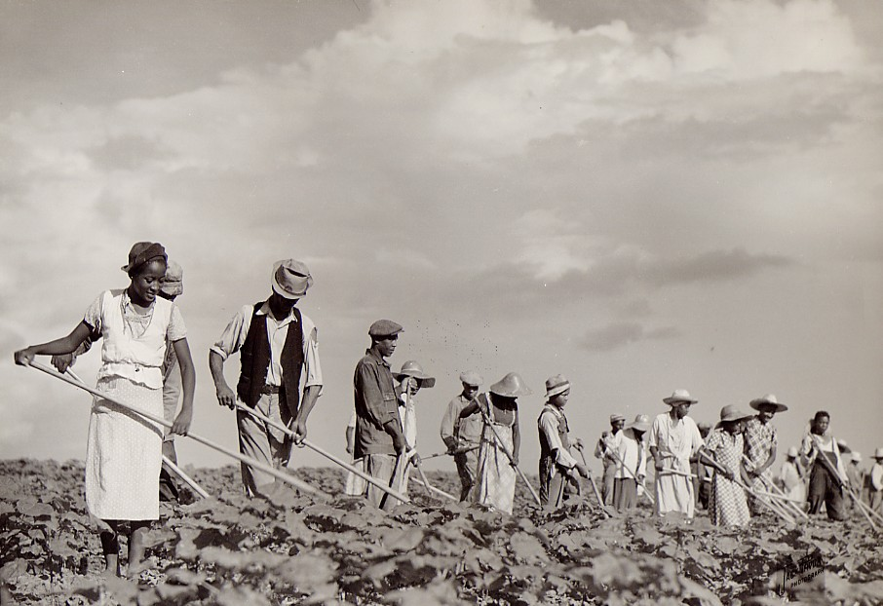
Arkansas Tenant Farmers,1936

Slide 20
NATIONAL YOUTH ADMINISTRATION
The National Youth Administration (NYA) was created to provide education, jobs and recreation for young people
Getting young people off the streets and into schools and jobs was a high priority for the NYA

Slide 21
CONGRESS PROTECTS WORKERS
In 1938, Congress passed the Fair Labor Standards Act
which set maximum hours at 44 per week
minimum wage at 25 cents per hour

Slide 22
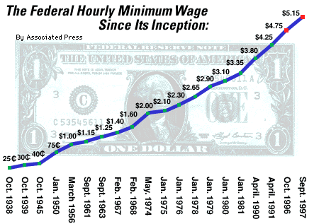

Slide 23
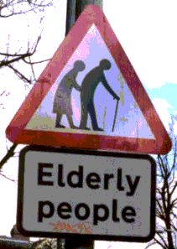
SOCIAL SECURITY ACT
One of the most important achievements of the New Deal era
It Gave:
Old-Age Pension
Unemployment compensation
Aid to families with dependent children & disabled (welfare)

Slide 24
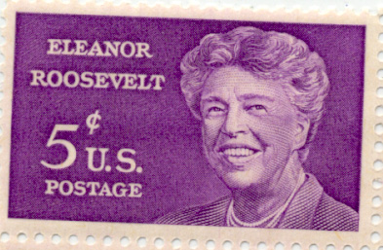
NEW DEAL AFFECTS MANY GROUPS
Postive effects for:
Women
African Americans
Native Americans
Eleanor & Franklin

Slide 25
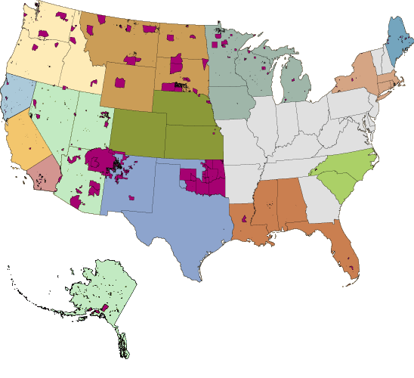
Current locations of Native American reservations

Slide 26
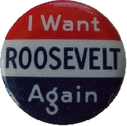
FDR WINS IN 1936 . . . AGAIN
FDR & Eleanor campaign by rail in 1936

Slide 27
THE IMPACT OF THE NEW DEAL
Over time, opinions about the merits of the New Deal and FDR have ranged from harsh criticism to high praise – usually along partisan lines
Conservatives felt FDR made government too large and too powerful
Liberals countered that FDR socialized the economy because Americans needed help

Slide 28
LEGACIES OF THE NEW DEAL
FDIC – banking insurance critical to sound economy
Deficit spending has became a normal feature of government
Social Security is a key legacy of the New Deal in that the Feds have assumed a greater responsibility for the social welfare of citizens since 1935

Slide 30
Other notes for test
Minorities jobs were taken by white employers and prejudice continued against minorities.
Every week about 85 million people went to the movies to escape their cares and worries.
Francis Townsend: a California doctor that is famous for creating a monthly pension.

Slide 31
Vocabulary to know
migrant worker: After the Dust Bowl people that moved place to place looking for work
pension: Money that an older person receives after retirement that is paid monthly
unemployment insurance: A tax that was put on workers and it funded people that lost their jobs is called

Slide 32
