Slide 1
The Evolution of video game technology

Slide 2
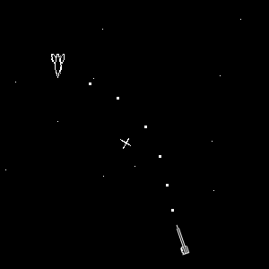
The Birth of the Industry
Spacewar! is the first popular video game
Arcade games are the first type of mainstream video games
Games operated by inserting a coin into the machine
Spacewar!

Slide 3
The Golden Age of Arcade Games
1978
Space Invaders!
1980
Pac-Man
1982
Donkey Kong
Video games began to become increasingly popular
Space Invaders was the #1 game for years
Soon replaced by Pac-Man, which became the most popular game

Slide 4
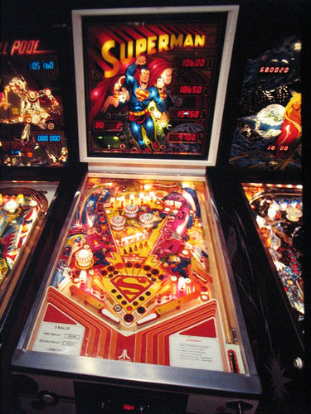
The Pinball Era
Evolved from shuffleboard and bocce ball
Were originally used as gambling devices
Two bumpers, one ball, and a crazy playing field
Play for the highest score

Slide 5
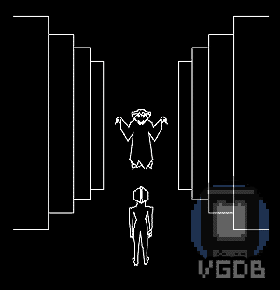
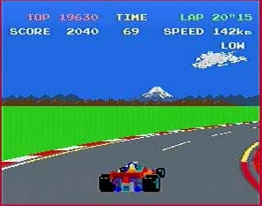
Home Computers
Home PC’s were new wave of gaming
Pole Position was very popular
Dungeons of Daggorath featured in the movie Big

Slide 6


Early Online Gaming
Many popular bulletin boards
Players would play gambling games
Played for points rather than money

Slide 7
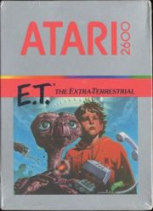
Video Game Crash of 1983
Way too many systems and games
Poorly designed games, including E.T. The Extra-Terrestrial massively overproduced
Many companies went out of business
Video game market looked bleak

Slide 8

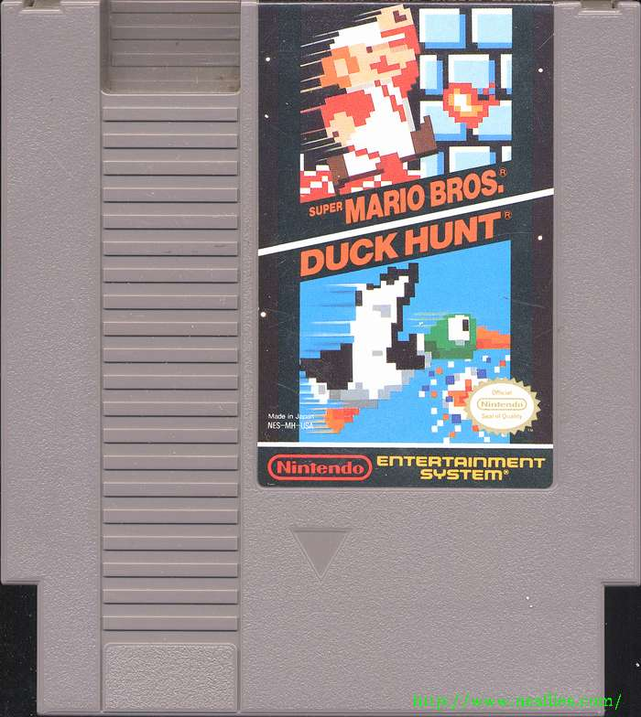
The Dawning of a New Era
Nintendo revitalizes an almost dead video game industry
Becomes most popular console ever, and paves the way for Xbox, Playstation, and the Wii
Super Mario

Slide 9
The Evolution of consoles

Slide 10

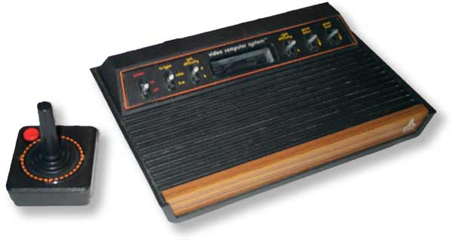
Atari
In 1976 Atari 2600 was the first game console and one of the most successful consoles in the history.

Slide 11

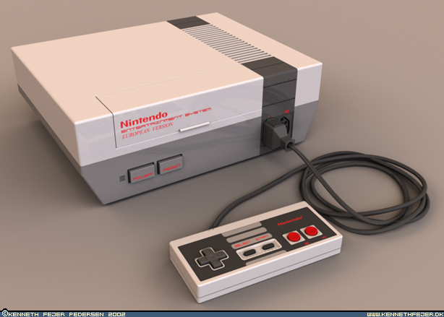

Nintendo is a Japanese multinational corporation.
In 1983 NES a 8-bit video game console,was realesed. It helped revitalize the video game industry and set the standard for subsequent consoles in everything from game to business practices.

Slide 12

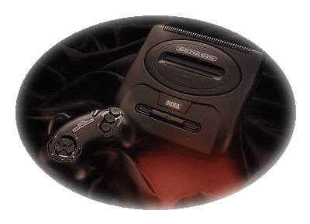

In 1989 Sega genesis was released in North America.
Sega was competing with Nintendo and had slogan such as “ Genesis does what Nintendon’t”

Slide 13
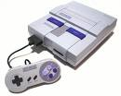

Super Nintendo
In 1990 SNES a 16 bit video game console was released. Which proved to be global success.

Slide 14
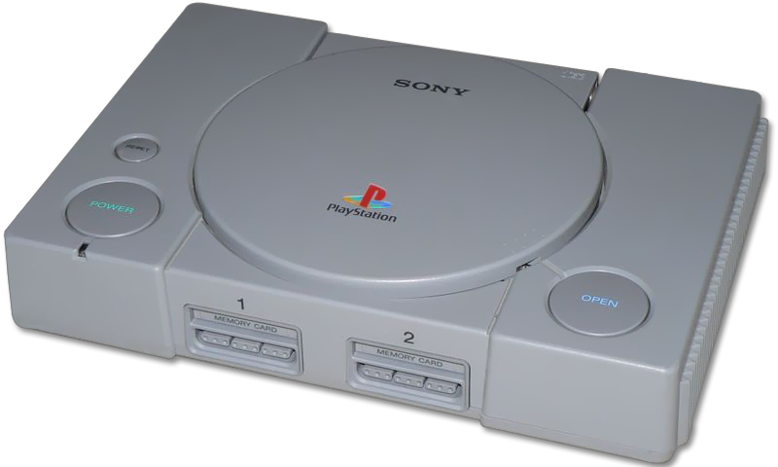
PlayStation
A 32-bit video game console of the fifth generation.
Released by Sony Computer Entertainment in 1994.
The original PlayStation.

Slide 15

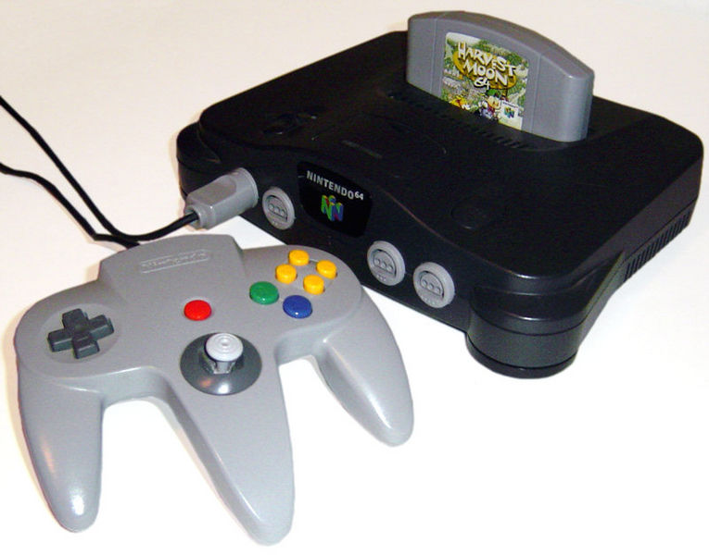

In 1996 N64 the 3rd generation of Nintendo game consoles was released.
N64 has sold over 32.93 million game consoles.

Slide 16

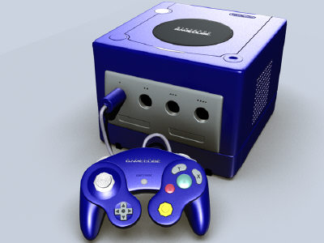

The 4th generation of Nintendo was released in 2001 and was the most compact and least expensive of its era of game consoles.
The game cube was designed for protability.

Slide 17
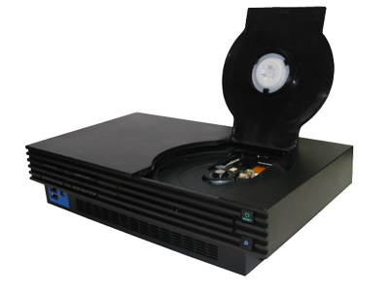
PlayStation 2
(release date 2000)
PS2 is a computer entertainment system is small, slim, and network ready and has over 1400 games to choose from.
Online gaming
Enhanced visuals and audios
DVD and CD player
Dual Shock Analog Controller
Flip Top cover

Slide 18

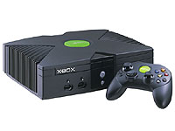
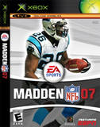
X-box was produced by Microsoft, it was Microsoft’s first into the gaming console market.
It was released in 2001.
The X-box has an online multiplayer gaming service called X-box live.

Slide 19

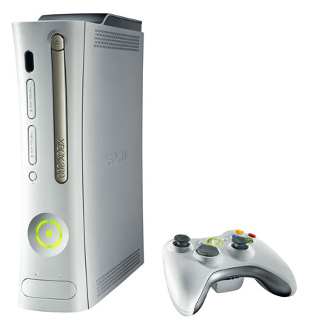

Released in 2005.
It was the first to provide wireless controller at launch.
The console completely sold out at release.

Slide 20
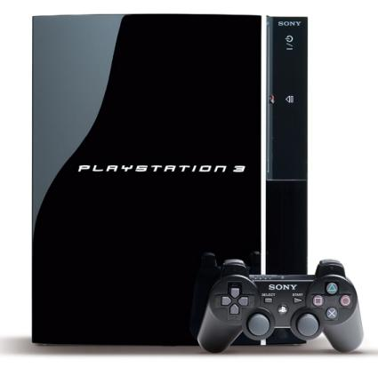
PlayStation 3 (released 2006)
PS3 is a brilliant high definition entertainment experience.
Cell Broadband Engine
Blue-Ray Disc
Online Connectivity
Six axis wireless controllers
PlayStation 3 comes with either a 40GB or 80GB removable hard disc drive.

Slide 21

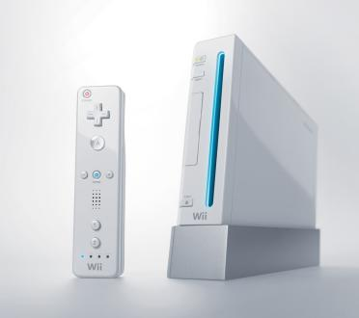
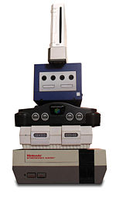
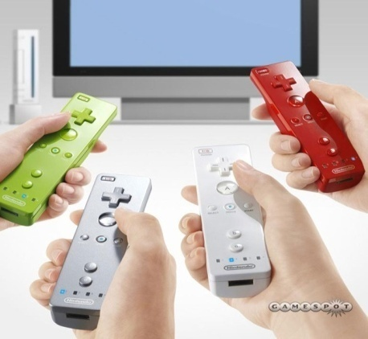
(2006) The Wii is the fifth home video game console releases by Nintendo. A new feature that the Wii offers is is wireless controller which can be used as a handheld pointing device and can detect acceleration in three dimensions.

Slide 22
PORTABLE CONSOLES

Slide 23
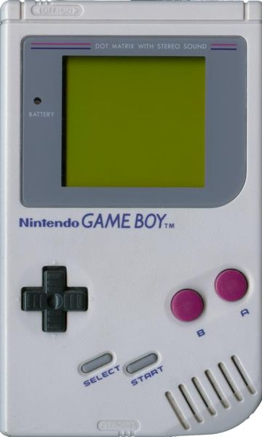
Game Boy
This was the first successful handheld console, and was the predecessor of all other models of the Game Boy line.
It was made in 1989, costing $89.95 at the time.

Slide 24
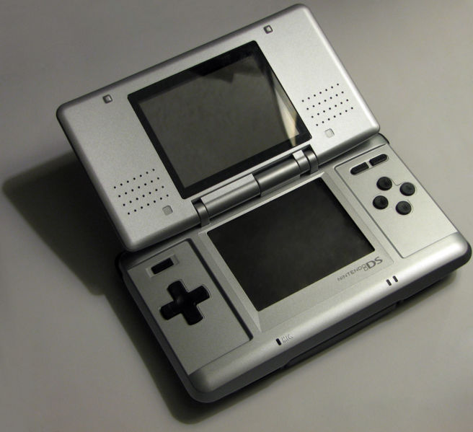
Game Boy DS
This handheld console was released in 2004 in Canada, the U.S., and Japan.
This console features a clamshell design similar to that of Game Boy Advance.
The DS has 2 screens one which is touch screen.
It has a built in microphone so players can interact with one another when playing multiplayer games or online games.
This was the 1st Nintendo game console to be released in North America prior to Japan.

Slide 25
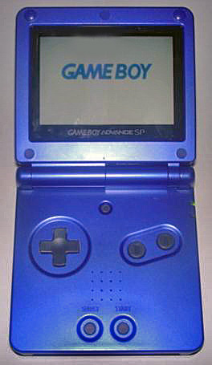
Game Boy Advance SP
This game boy was launched in 2004 also, but cost $99.99 at release.
The SP stands for special.
It has a back-lit flip screen, smooth lines, and color selection.

Slide 26
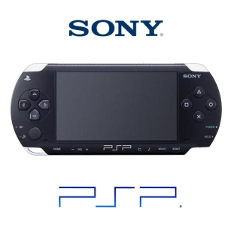
PlayStation Portable
The PlayStation Portable system is the first truly integrated portable entertainment system.
It was designed to handle multiple applications.
Games (key feature)
Music
Video
Photo
Internet
Wireless Connectivity

Slide 27
Video Games and Addiction

Slide 28

Virtual Junkies
Almost 90 million adult Americans play computer and video games
Like younger people, some play way too much
This addiction leaves their real lives and families to fall apart

Slide 29
Accessibility for Gamers
Over 145 million Americans played computer or video game in 2002
  That’s 60% of the country’s population age 6 or older
That’s reasonable when 45% of households have a video game console
In 2002 9 million consoles were sold
  That equals out to two per household

Slide 30
Forms of Gaming
There are two forms of gaming
  Offline
    Games like Grand Theft Auto, that is played on a computer or game console such as a Xbox
  Online
    Games such as EverQuest, that are played with a broadband connection(preferably) that usually charges a small fee

Slide 31
What is Addiction?
Video game addiction is not a statistic but would be similar to any other psychological addiction
It is considered to be an impulse control disorder

Slide 32
Possible Causes
According to AMA in June of 2007, those who overuse video games, do so because they are more successful in conducting virtual relationships than real-world relationships

Slide 33
Symptoms of Addiction
Persistent thoughts of playing the game
Use the game to escape problems
Increased time spent with game to receive same satisfaction
Inability to control, stop or diminish the behavior

Slide 34
Symptoms Continued
Irritability when prevented from playing the game
Lying about extent of involvement with the game

Slide 35
Affects of Addiction
A 2004 study showed 4 common indicators
  Shyness
  Lack of spiritual faith
  Belief of other controlling their lives
  Elevated belief in chance as an influence on their lives

Slide 36


